Slide 1
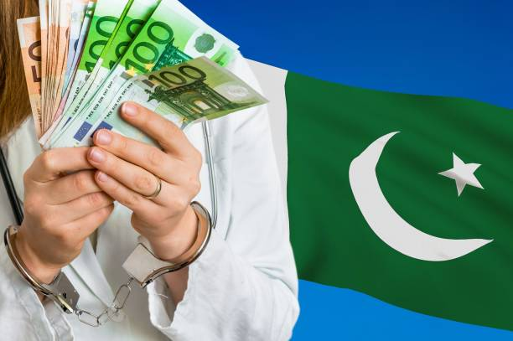
Corruption in Pakistan

Slide 2
Agenda:
What is Corruption
Types of Corruption
Corruption scandals of: (Asif Ali Zardari, Nawaz Sharif and Imran khan)
Pakistan Corruption index
Reasons of Corruption
ills of Corruption
Remedies to deal with Corruption

Slide 3
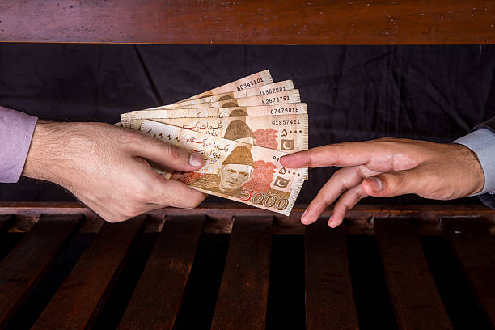
What is Corruption
We define corruption as the abuse of entrusted power for private gain. Corruption erodes trust, weakens democracy, hampers economic development and further .

Slide 4
Types of Corruption
Supply versus Demand Corruption
Grand versus Petty Corruption
Conventional versus Unconventional Corruption
Public versus Private Corruption

Slide 5
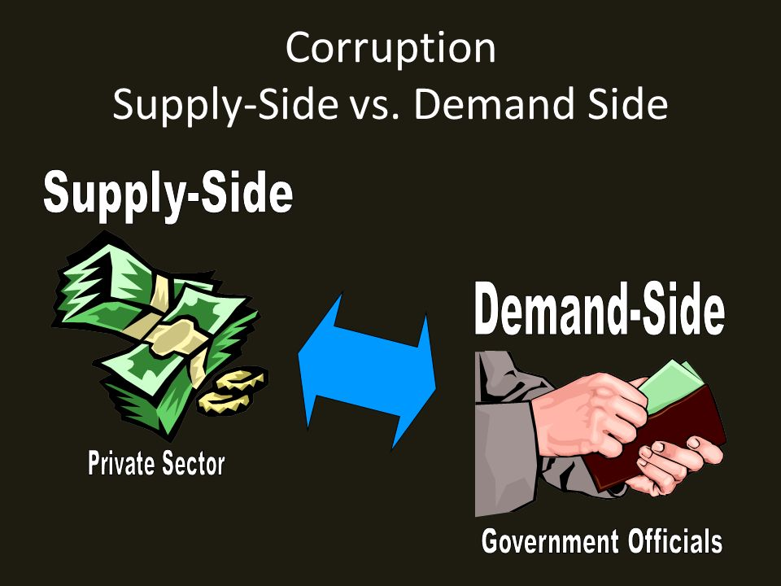
Supply versus Demand Corruption
Supply - side corruption is used to describe the act of offering an illicit payment or undue advantage, whereas Demand - side corruption relates to the acceptance or solicitation of such a payment or advantage

Slide 6
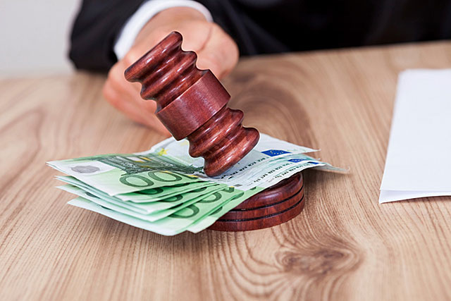
Conventional versus Unconventional Corruption.
Conventional Corruption occurs when government officials, whether lower or higher ranking, illegitimately receive or accumulate an undue advantage for their own personal use, disregarding personal interest.
Unconventional Corruption exists where a public or government officials acts without consideration for specific and personal gain.

Slide 7
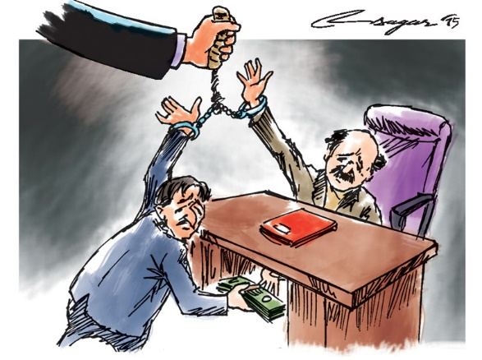
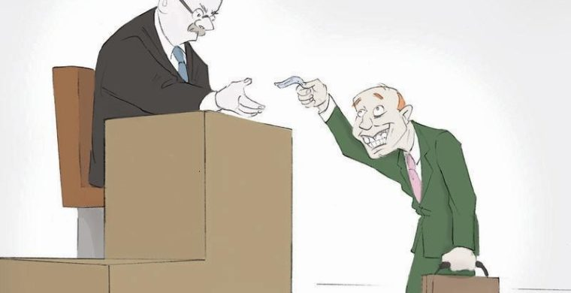
Grand versus Petty Corruption
Grand and Petty Corruption or both sub - categories of unconventional corruption is sometimes equated with “bureaucratic corruption, “ Which implies involvement of public administration officials and non – elected officials.

Slide 8
Public versus Private Corruption
“ Public Corruption “ Public corruption is the violation of a public official’s duty of faith toward his or her community. Most public corruption occurs when an official is offered something of value in exchange for a favorable decision. Public corruption can be committed on the federal, state, or local level by anyone elected, appointed, hired, or otherwise in the employ of a constituency of citizens.
“Private Corruption” Private Corruption occurs when a person or Group of Persons are Given unfair preferential treatment at the Expense of others.

Slide 9
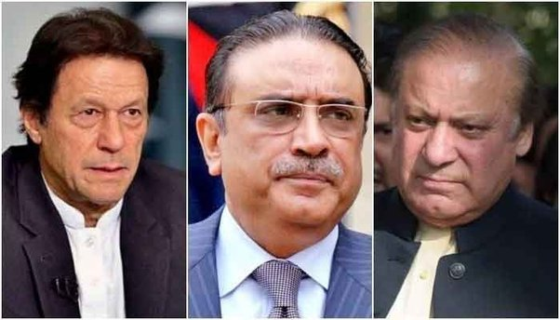
Corruption scandals
Asif Ali Zardari among bigwigs named in fake bank accounts, money laundering cases.
Nawaz Sharif found guilty in two corruption references.
Imran Khan is dishonest, corrupt, and money – launderer.

Slide 10
Asif Ali Zardari among bigwigs named in fake bank accounts, money laundering cases.
The Fake accounts case is a case being heard by the Supreme Court of Pakistan (SCP) under which former President of Pakistan Asif Ali Zardari,accused of money laundering through 29 fake accounts registered in Summit Bank, Sindh Bank, and United Bank Limited under people's names who themselves were not aware of those accounts.
Facts: two more companies M/s Landmarks and M/s NGS. The M/s Landmark is owned by Zardari, Faryal Talpur and Azra Ali

Slide 11
Nawaz Sharif found guilty in two corruption references.
1. Al – Azizia Reference:
Nawaz handed 7 years in jail in Al-Azizia reference.
Fined Rs1.5 billion, US $25 million.
2. Panama Papers Case:
Former Pakistan Prime Minister Nawaz Sharif has been sentenced to 10 years in prison and fined $10.6 million on corruption charges linked to 2016 Papers revelations about his family’s properties overseas.

Slide 12
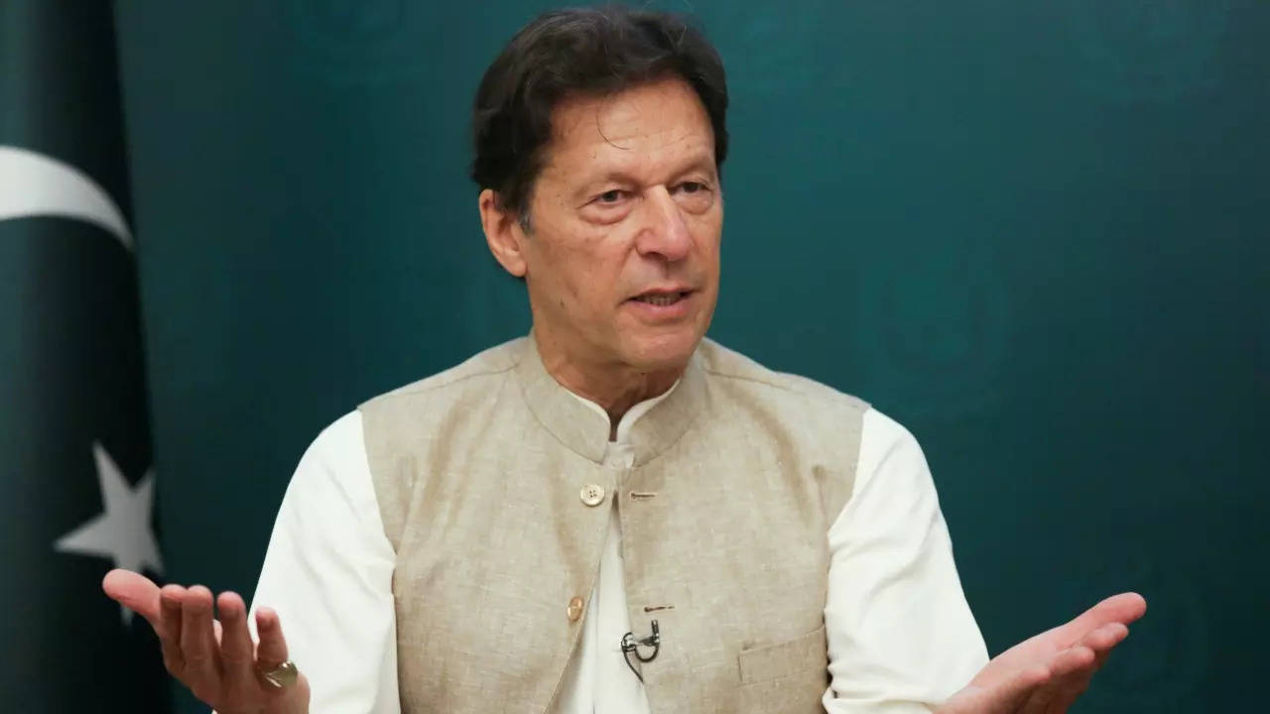
Imran Khan is dishonest, corrupt, and money – launderer.
ECP verdict on PTI foreign funding case charge sheets Imran Niazi for violating the Constitution, submitting false affidavits & accepting foreign money. Proven yet again that he is a certified liar. Nation should ponder over the implications of his politics funded by foreigners.

Slide 13
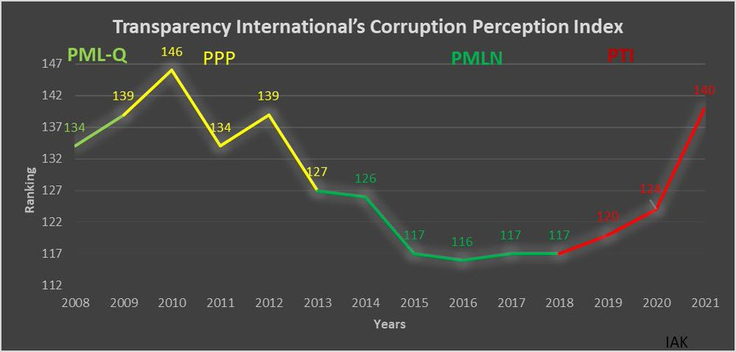
Pakistan Corruption index

Slide 14
Reasons of Corruption
Feudalistic politics in Pakistan
Lack of transparency in public sector
Soft Forgiving Culture (NRO)
Poor Judicial Infrastructure
Weak and corrupt Law enforcing institutions

Slide 15
ills of Corruption
Energy, Economic and water crisis in Pakistan
Promotes crimes and disturbs the social fabric
Brings poverty and inflation the citizens
Tarnishes the image of country
Halts the economic progress of a country

Slide 16
Remedies to deal with Corruption
Strong Legal framework and enforcement of law
Reforming public administration and finance management
Closing international Loopholes
Empowering the public through awareness campaigners
Holding the corrupt accountable

Slide 17
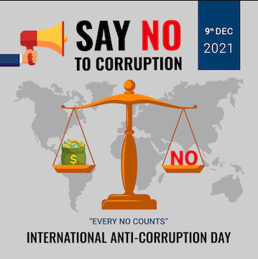

Slide 18


